Slide 1
Canning River Canoe Club
2020 / 21
End of season awards dinner

Slide 2
2020-2021 Tuesday night Paddling Season
who’s who
Here’s a quick reminder of who paddled this season at both Kent Street and Shelley Tuesday evening events.
Paddlers listed in order of number of Tuesday Night paddle Nomination events with completed times
In summary, 63 different paddlers paddled on a Tuesday evening last season (3 more than the previous year)

Slide 3
20-21 Tuesday night Paddling Season
who’s who

Slide 4
20-21 Tuesday night Paddling Season
who’s who

Slide 5
20-21 Tuesday night Paddling Season
who’s who

Slide 6
Historic Time Trial Participation
Each year we recognise those paddlers who have reached milestones in terms of the number of CRCC Tuesday night time trials they have participated in.
The count only considers nomination and 3 week PB time trials (not count down races as no timing records are kept).
So ....

Slide 7
Historic Time Trial Participation
Congratulations to these paddlers who have reached the
50 CRCC Time Trial milestone
No New 50’s

Slide 8
Historic Time Trial Participation
Congratulations to these paddlers who have reached the
100 CRCC Time Trial milestone

Slide 9
Historic Time Trial Participation
Congratulations to these paddlers who have reached the
100 CRCC Time Trial milestone
Chris Graham
Connor Jacob
Lafe Jacob
Beau Jacob
Dave Boldy
Luc Jacob
Matt Jacob
Noah Boldy

Slide 10
Historic Time Trial Participation
Congratulations to these paddlers who have reached the
200 CRCC Time Trial milestone

Slide 11
Historic Time Trial Participation
Congratulations to these paddlers who have reached the
200 CRCC Time Trial milestone
Doug Hodson
Richard Tempest
Stuart Hyde

Slide 12
Historic Time Trial Participation
Congratulations to these paddlers who have reached the
300 CRCC Time Trial milestone

Slide 13
Historic Time Trial Participation
Congratulations to these paddlers who have reached the
200 CRCC Time Trial milestone
None this year
(Note David Gardiner and Simon O’Sullivan both cracked 250 this year)
Existing 300 TT
Steve Coward Cindy Coward Christian Thompson

Slide 14
Time Trial Participation
We also continue to award exceptional Nomination Results during the past season
CRCC 3 Club, CRCC 2 Club and CRCC 1 Club are awarded on the night they occur.
Zero Club winners are announced here and have their names engraved on the trophy

Slide 15
Time Trial Participation
Congratulations to these paddlers who have achieved the
Existing CRCC Zero Club Members
Christian Thompson | Dave Griffiths | Mike Laloli
Louis Botes (2) | Simone Burge | David Urquhart
Mark Lawson | Simon O’Sullivan | Kristian Maliphant
Roland Bodt | Stuart Hyde (3)
Joe Wilson (2) | Gary Killian
Jeff Lohrey | Morgan Boldy
David McCauley | Joe Wilson
Mike Galanty | Steve Mitchinson,
Luc Jacob (2) | Mike Laloli
David Gardiner | Malachy Condon
Doug Hodson | Connor Jacob
David Griffiths | Lafe Jacob

Slide 16
Time Trial Participation
Congratulations to these paddlers who have achieved the
20/21 CRCC Zero Club Winners

Slide 17
Time Trial Participation
Congratulations to these paddlers who have achieved the
20/21 CRCC Zero Club Winners
Stuart Hyde
Doug Hodson (twice)
Matt Jacob
Luc Jacob
David Tempest
Richard Tempest
Simon O’Sullivan
Chris Graham
Alistair Fox
Peter Gigengack
A record 10 winners this year

Slide 18
Presidents Cup History
CRCC’s most prestigious award
Presented to the paddler who achieves the 10 lowest total nomination times in the paddling year

Slide 19
But first a look at this seasons 20/21 results and records
Kent Street Weir
Riverton Bridge
October 1st
April 1st
September 31st

Slide 20
Kent Street Weir
Course
Kent Street Weir
October 1st
April 1st

Slide 21
Kent Street Course
5.65km – Kent Street Weir to Riverton Bridge return
Fastest K1 Times this season
Club Record Tim Hyde - 25min 21 sec, 15th Jan 2019, 900mm Water, Strong wind

Slide 22
Kent Street Course
5.65km – Kent Street Weir to Riverton Bridge return
Fastest K1 Times this season
Club Record retained by Tim Hyde - 25min 21 sec
Pos | Paddler | Depth | Wind | Time
1 |  | Noah Boldy | 800mm |  | 5 Knotts | 0:26:30
2 |  | Kristian Maliphant | 1170mm |  | 0 knotts | 0:27:10
3 |  | Stuart Hyde | 800mm |  | 5 Knotts | 0:27:15
4 |  | Connor Jacob | 1100mm |  | 0 knotts | 0:27:25
5 |  | Carlo Cottino | 890mm |  | 15 knotts | 0:27:38
6 |  | Joseph Campbell | 1150mm |  | 5 knotts | 0:29:21
7 |  | Simon O'Sullivan | 780mm |  | 20 knotts | 0:30:07
8 |  | Alessio Cottino | 780mm |  | 20 knotts | 0:30:10
9 |  | Doug Hodson | 1150mm |  | 5 knotts | 0:30:19
10 |  | Tom Green | 750mm |  | 15 knotts | 0:31:11
11 |  | Jake Hammond | 1100mm |  | 0 knotts | 0:31:15

Slide 23
Kent Street Course
5.65km – Kent Street Weir to Riverton Bridge return
Fastest Doubles Times (K2 / Double Ski /Double Plastic)
Course Record Luke Egger & Tom Green - 24m 21s

Slide 24
Kent Street Course
5.65km – Kent Street Weir to Riverton Bridge return
Fastest Doubles Times (K2 / Double Ski /Double Plastic)
Course Record retained by Luke Egger & Tom Green - 24m 21s
Pos | Paddler | Depth | Wind | Time
1 |  | Connor and Noah | 840mm | 10 knotts | 0:25:08
2 |  | Stuart Hyde & Steven Kiss | 1190mm | 5 Knots | 0:25:53
3 |  | David and Noah Boldy | 650mm | 8 knotts | 0:27:35
4 |  | Matt Jacob & Luc Jacob | 750mm | 15 knotts | 0:28:07
5 |  | David MacCaulay & Luc Jacob | 650mm | 8 knotts | 0:28:31
6 |  | Simon O'Sullivan & Doug Hodson | 1220mm | 10 knotts | 0:28:50
7 |  | David Boldy & David Urquhart | 800mm | 5 Knotts | 0:29:21
8 |  | Lafe and Beau Jacob | 1100mm | 0 knotts | 0:29:24
9 |  | David MacCauley & Eve McNicoll | 1150mm | 5 knotts | 0:29:28
10 |  | Doug Hodson & Davve Boldy | 750mm | 15 knotts | 0:29:34

Slide 25
Kent Street Course
5.65km – Kent Street Weir to Riverton Bridge return
Fastest Ski Times
Course Record Mark Lawson, 26m 24s

Slide 26
Kent Street Course
5.65km – Kent Street Weir to Riverton Bridge return
Fastest Ski Times
Course Record retained by Mark Lawson, 26m 24s
Pos | Paddler | Depth | Wind | Time
1 |  | David McCaulay | 1170mm | 0 knotts | 0:27:11
2 |  | Steven Kiss | 880mm | 15 knotts | 0:28:04
3 |  | Matt Jacob | 880mm | 15 knotts | 0:29:28
4 |  | Simon O'Sullivan | 880mm | 15 knotts | 0:29:32
5 |  | Luc Jacob | 1180mm | 10 knotts | 0:31:20
6 |  | Alistair Fox | 900mm | 10 knotts | 0:31:45
7 |  | David Boldy | 1050mm | 10 knotts | 0:32:16
8 |  | David Urquhart | 880mm | 10 knotts | 0:32:31
9 |  | Joe Wilson | 1150mm | 5 knotts | 0:32:57
10 |  | Louis Botes | 900mm | 10 knotts | 0:33:25

Slide 27
Kent Street Course
5.65km – Kent Street Weir to Riverton Bridge return
Fastest Long Plastic Times
Course Record Tim Coward - 29m 28s

Slide 28
Kent Street Course
5.65km – Kent Street Weir to Riverton Bridge return
Fastest Long Plastic Times
Course Record retained Tim Coward - 29m 28s
Pos | Paddler | Depth | Wind | Time
1 Long Plastic Mike Galanty 1190mm 5 Knotts 0:42:11

Slide 29
Kent Street Course
5.65km – Kent Street Weir to Riverton Bridge return
Fastest Ladies
Club Record Karen Green- 35m 07s

Slide 30
Kent Street Course
5.65km – Kent Street Weir to Riverton Bridge return
Fastest Ladies
New Club Record by McNicoll 32m 24s, 5knts, 1200mm
Pos | Paddler | Depth | Wind | Time
1 |  | Eve McNicoll | 1200mm | 5 knotts | 0:32:24
2 |  | Nishani Jacob | 500mm | 5 knotts | 0:33:32
3 |  | Olivia Campbell | 890mm | 5 knotts | 0:33:45
4 |  | Shona Thomlinson | 500mm | 5 knotts | 0:36:43
5 |  | Ruth Campbell | 890mm | 5 knotts | 0:38:33
6 |  | Simone Burge | 1060mm | 20 knotts | 0:38:57
7 |  | Rachel Campbell | 1050mm | 5 Knotts | 0:38:57
8 |  | Donna West | 1220mm | 10 knotts | 0:43:08

Slide 31
Kent Street Short Course
3.72km – Kent Street Weir to short cut island return
Course Record David Gardiner- 22m 49s

Slide 32
Kent Street Short Course
3.72km – Kent Street Weir to short cut island return
Course Record retained by David Gardiner- 22m 49s
Pos’n | Paddler | Depth | Wind | Time
1st | David Gardiner | 1170mm | 0 kntts | 0:22:56

Slide 33
Kent Street Course Perpetual Record
3.72km – Kent Street Weir to Riverton Bridge return
Fastest Ever Times

Slide 34
Kent Street Course Perpetual Record
3.72km – Kent Street Weir to Riverton Bridge return
Fastest Ever Times
Pos | Paddler & Boat | Depth | Wind | Time
1 |  | David Gardiner | Ski | 610mm | 10 knotts | 0:22:49
2 |  | Simone Burge | K1 | 730mm | 5 knotts | 0:23:30
3 |  | Dean Wingfield | TK1 | 1170mm | 0 knotts | 0:24:53
4 |  | Christian Thompson | Ski | 730mm | 10 knotts | 0:24:58
5 |  | Vic Barnden | Short Plastic | 890mm | 0 knotts | 0:26:24
6 |  | Dolph Witt | Short Plastic | 980mm | 5 knotts | 0:26:36
7 |  | Jan Botha | TK1 | 1010mm | 5 Knotts | 0:28:48
8 |  | Mary-Jo Harris | Ski | 1200mm | 5 Knts | 0:29:10
9 |  | Les Siemsen | Short Plastic | 850mm | 5 knts | 0:29:59
10 |  | Donna West | Short Plastic | 1200mm | 5 Knts | 0:31:16

Slide 35
Riverton Bridge
Course
Riverton Bridge
April 1st 2017
September 31st 2017

Slide 36
Riverton Bridge Course
5.15km
Fastest K1 Times
Course Record Luke Egger - 22m 58s

Slide 37
Riverton Bridge Course
5.15km
Fastest K1 Times
New Course Record Noah Boldy- 22m 40s
Pos | Paddler | Depth | Wind | Time
1 |  | Noah Boldy | 300mm | 0 Knotts | 0:22:40
2 |  | Stuart Hyde | 300mm | 0 Knotts | 0:24:36
3 |  | Connor Jacob | 300mm | 0 Knotts | 0:24:37
4 |  | Mike Laloli | 460mm | 0 Knotts | 0:27:05
5 |  | Simon O'Sullivan | 500mm | 5 knotts | 0:27:24
6 |  | Tim Coward | -100mm | 0 knotts | 0:27:50
7 |  | Doug Hodson | 250mm | 5 Knotts | 0:28:11
8 |  | Carlo Cottino | 10mm | 0 Knotts | 0:28:18
9 |  | Jake Hammond | 500mm | 5 knotts | 0:28:20
10 |  | Ken Ringrose | 300mm | 10 knotts | 0:29:00

Slide 38
Riverton Bridge Course
5.15km
Fastest Doubles Times (K2 / Double Ski /Double Plastic)
Equal Course Record Noah Boldy & Elijah Sparrow
Mike Laloli & Ken Ringrose - 24m 05s

Slide 39
Riverton Bridge Course
5.15km
Fastest Doubles Times (K2 / Double Ski /Double Plastic)
Equal Course Record retained Noah Boldy & Elijah Sparrow
Mike Laloli & Ken Ringrose - 24m 05s
Pos | Paddler | Depth | Wind | Time
1 | Dski | David and Noah Boldy | 220mm | 15 knotts | 0:25:18
2 | Dski | David Boldy & Doug Hodson | 500mm | 5 knotts | 0:27:11
3 | K2 | Lafe and Beau Jacob | 160mm | None | 0:27:34
4 | Dski | David Boldy & David Mac | -10mm | 5 knotts | 0:27:48
5 | Dski | Doug Hodson & David Boldy | 10mm | 0 Knotts | 0:28:36
6 | K2 | David Boldy & David Stevens | -50mm | 5 knotts | 0:28:43
7 | Dski | Richard & David Tempest | 500mm | 5 knotts | 0:29:04
8 | K2 | Steve & Cindy Coward | 500mm | 5 knotts | 0:31:00
9 | K2 | Georgia Mackey & Matt Jacob | 310mm | 8 Knotts | 0:31:59

Slide 40
Riverton Bridge Course
5.15km
Fastest Ski Times
Equal Course Record Dave McCauley,
Gianluca Cottino 24m 32s

Slide 41
Riverton Bridge Course
5.15km
Fastest Ski Times
Equal Course Record retained Dave McCauley,
Gianluca Cottino 24m 32s
Pos | Paddler | Depth | Wind | Time
1 |  | David McCaulay | 540mm | 10 Knotts | 0:25:13
2 |  | Kristian Maliphant | 310mm | 8 Knotts | 0:25:32
3 |  | Steven Kiss | 300mm | 0 Knotts | 0:26:42
4 |  | Lafe Jacob | 310mm | 8 Knotts | 0:26:49
5 |  | Simon O'Sullivan | 300mm | 10 knotts | 0:26:56
6 |  | Peter Gigengack | 300mm | 10 knotts | 0:27:27
7 |  | Alistair Fox | 500mm | 5 knotts | 0:28:54
8 |  | David Boldy | 250mm | 5 Knotts | 0:29:42
9 |  | Luc Jacob | 25mm | 5 knotts | 0:30:07
10 |  | David Urquhart | 460mm | 0 Knotts | 0:30:28
11 |  | Joss Doak-Smith | 250mm | 0 Knotts | 0:30:30

Slide 42
Riverton Bridge Course
5.15km
Fastest Long Plastic Times
Course Record David McCauley- 27m 56s, 5knt, 100mm

Slide 43
Riverton Bridge Course
5.15km
Fastest Long Plastic Times
Course Record retained David McCauley- 27m 56s, 5knt, 100mm
Pos’n | Paddler | Depth | Wind | Time
1st | Chris Graham | 500mm | 5 knotts | 0:34:32
2nd | Mike Galanty | -50mm | 5 knotts | 0:38:32

Slide 44
Riverton Bridge Course
Riverton Bridge Course 5.15km
Fastest Ladies
Course Record Jaymee-Lee Martin 27 May 2014 - 26m 42s

Slide 45
Riverton Bridge Course
Riverton Bridge Course 5.15km
Fastest Ladies
Course Record retained Jaymee-Lee Martin 27 May 2014 - 26m 42s
Pos | Paddler | Depth | Wind | Time
1 |  | Eve McNicoll | 540mm | 10 Knotts | 0:31:57
2 |  | Christine McCafferty | 250mm | 5 Knotts | 0:33:19
3 |  | Nishani Jacob | 500mm | 5 knotts | 0:33:32
4 |  | Cindy Coward | 540mm | 10 Knotts | 0:36:11

Slide 46
Presidents Cup
This year the number of paddlers who qualified for the Presidents cup was 31.
These paddlers completed at least 10 time trials during the year and are in the running to win CRCC’s most prestigious trophy.
This year I also show the number of time trials that their total was made over. So lets count them down …

Slide 47
Presidents Cup
Position | Paddler | No. Nom's | Score
21 | Steven Kiss | 11 | 221
22 | Nishani Jacob | 17 | 243
23 | Alistair Fox | 15 | 257
24 | Mike Galanty | 28 | 266
25 | Steve Coward | 31 | 266
26 | Christian Thompson | 15 | 293
27 | Joss Doak-Smith | 13 | 311
28 | Peter Burge | 10 | 376
29 | Donna West | 10 | 510
30 | Cindy Coward | 10 | 578
31 | David Stevens | 20 | 658

Slide 48
Social Paddler of the year
Judged by the CRCC committee includes contribution to the club including attendance at club nights and competitions

Slide 49
Social Paddler of the year
Judged by the CRCC committee includes contribution to the club including attendance at club nights and competitions
Diane Greenaway
Diane has taken out this award for the second straight year and reflects her dedication to the social paddling team.

Slide 50
Tim Coward Perpetual Trophy
Junior Paddler of the year
Judged by the CRCC committee. Guideline : Awarded to the most elite junior paddler of the paddling year

Slide 51
Tim Coward Perpetual Trophy
Junior Paddler of the year
Judged by the CRCC committee. Guideline : Awarded to the most elite junior paddler of the paddling year
Noah Boldy

Slide 52
Coaches Award
Judged by the club coaches and ratified by Committee. The paddler showing the most dedication or commitment to training or the club.

Slide 53
Coaches Award
Judged by the club coaches and ratified by Committee. The paddler showing the most dedication or commitment to training or the club.
Alistair Fox

Slide 54
Presidents Cup
Presidents Cup continues

Slide 55
Presidents Cup
Position | Paddler | No. Nom's | Score
11 | David Boldy | 29 | 104
12 | Matt Jacob | 28 | 105
13 | Luc Jacob | 32 | 107
14 | David Gardiner | 35 | 110
15 | Louis Botes | 34 | 116
16 | Joe Wilson | 22 | 134
17 | Lafe Jacob | 26 | 159
18 | Chris Graham | 24 | 166
19 | Beau Jacob | 25 | 179
20 | Eve McNicoll | 30 | 190

Slide 56
Most Improved Paddler – The Steve Bird Trophy
Guideline : Judged by the Committee as the paddler demonstrating the most improved paddle times over the season

Slide 57
Most Improved Paddler – The Steve Bird Trophy
Guideline : Judged by the Committee as the paddler demonstrating the most improved paddle times over the season
Connor Jacob

Slide 58
Most Improved Junior Paddler
Guideline : Judged by the Committee as the junior paddler demonstrating the most improved paddle times over the season

Slide 59
Most Improved Junior Paddler
Guideline : Judged by the Committee as the junior paddler demonstrating the most improved paddle times over the season
Beau Jacob

Slide 60
K2/S2 Team Boat Challenge
Lloyd Noel Perpetual Trophy
Outright
&
Handicap

Slide 61
K2/S2 Team Boat Challenge
Lloyd Noel Perpetual Trophy
Outright
Connor Jacob
&
Noah Boldy

Slide 62
K2/S2 Team Boat Challenge
Lloyd Noel Perpetual Trophy
Handicap
Dave Boldy
&
Doug Hodson

Slide 63
K4 Team Boat Challenge
David Griffiths Perpetual Trophy
Outright
&
Handicap

Slide 64
K4 Team Boat Challenge
David Griffiths Perpetual Trophy
Outright
Carlo Cottino
Simon O’Sullivan
Kristian Maliphant
Dave McCaulay

Slide 65
K4 Team Boat Challenge
David Griffiths Perpetual Trophy
Handicap
Stuart Hyde
Carlo Cottino
Doug Hodson
David McCaulay

Slide 66
Volunteer of the year
The Dave Brown Medal
Judged by the CRCC committee

Slide 67
Volunteer of the year
The Dave Brown Medal
Judged by the CRCC committee
David Griffiths

Slide 68
Clubman of the year
The Thompson Medal
Judged by the CRCC committee includes contribution to the club including attendance at club nights and competitions

Slide 69
Clubman of the year
The Thompson Medal
Judged by the CRCC committee includes contribution to the club including attendance at club nights and competitions
David Gardiner

Slide 70
Presidents Cup
And now into the top 10

Slide 71
Presidents Cup
Position | Paddler | No. Nom's | Score
6 | Peter Gigengack | 13 | 87
7 | Richard Tempest | 30 | 92
8 | Stuart Hyde | 24 | 94
9 | David Tempest | 19 | 98
10 | Connor Jacob | 30 | 103

Slide 72
Jerry Alderson Plate
Senior Paddler of the Year
Judged by the CRCC committee.
Guideline : Awarded to the most elite senior paddler of the paddling year, Over 35.

Slide 73
Jerry Alderson Plate
Senior Paddler of the Year
Judged by the CRCC committee.
Guideline : Awarded to the most elite senior paddler of the paddling year, Over 35.
Kristian Maliphant

Slide 74
Presidents Cup
10 event nomination ecelectic for Senior Distance Paddlers
Position | Paddler | No. Nom's | Score
1
2
3
4
5

Slide 75
Presidents Cup
10 event nomination ecelectic for Senior Distance Paddlers
Position | Paddler | No. Nom's | Score
1
2
3
4
5 | Jake Hammond | 19 | 85

Slide 76
Presidents Cup
10 event nomination ecelectic for Senior Distance Paddlers
Position | Paddler | No. Nom's | Score
1
2
3
4 | Doug Hodson | 29 | 55
5 | Jake Hammond | 19 | 85

Slide 77
Presidents Cup
10 event nomination ecelectic for Senior Distance Paddlers
Position | Paddler | No. Nom's | Score
1
2
3 | David McCaulay | 34 | 54
4 | Doug Hodson | 29 | 55
5 | Jake Hammond | 19 | 85
So who’s left in it?

Slide 78
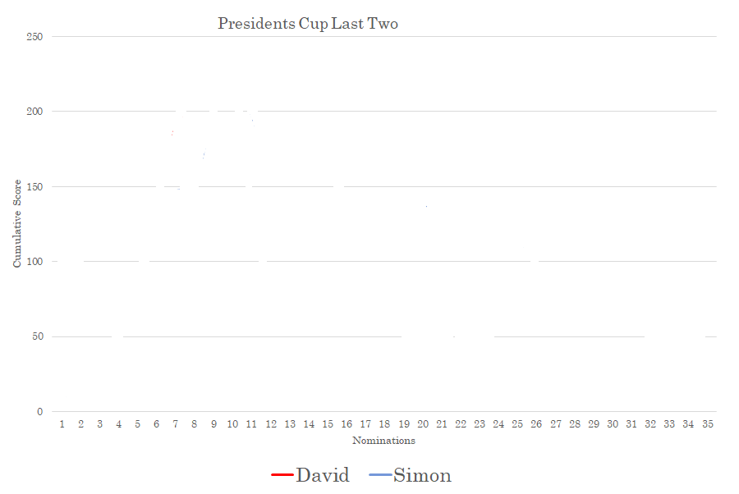

Slide 91
Presidents Cup
10 event nomination ecelectic for Senior Distance Paddlers
Position | Paddler | No. Nom's | Score
1
2
3 | David McCaulay | 34 | 54
4 | Doug Hodson | 29 | 55
5 | Jake Hammond | 19 | 85
This year for the first time ever!

Slide 92
Presidents Cup
10 event nomination ecelectic for Senior Distance Paddlers
Joint winners!
Position | Paddler | No. Nom's | Score
1 | David Urquhart | 24 | 46
1 | Simon O'Sullivan | 35 | 46
3 | David McCaulay | 34 | 54
4 | Doug Hodson | 29 | 55
5 | Jake Hammond | 19 | 85

Slide 93
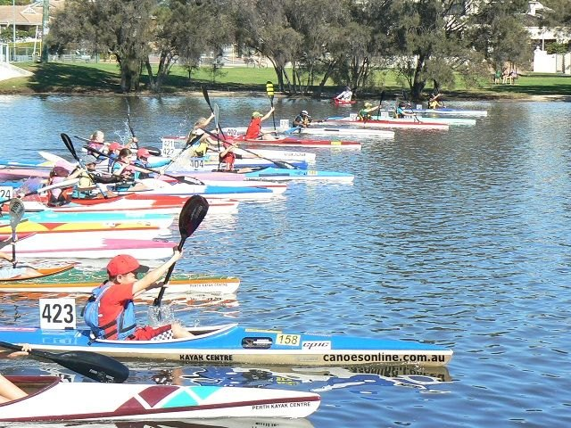
Oldenhoff Medal (Junior Presidents Cup)
10 event nomination ecelectic for juniors.

Slide 94
Oldenhoff Medal (Junior Presidents Cup)
10 event nomination ecelectic for juniors.
Connor Jacob (103)

Slide 95
The Fish Award
Judged by the CRCC committee.
Guideline : Most noted member of the year. The club member most discussed or participated in the most funniest event, not malicious but judged for fun.

Slide 96
The Fish Award
Judged by the CRCC committee.
Guideline : Most noted member of the year. The club member most discussed or participated in the most funniest event, not malicious but judged for fun.
Louis Botes
For the paddler most talked about on the water (and most worried about) although Joe went close mostly through his challenges travelling during COVID

Slide 97
Thankyou
Good luck for 2021 / 22 paddling season

Slide 98
Jeff Burgland Trophy - Paddler of the year
Judged by the CRCC committee.
Guideline : Awarded to the most elite paddler of the paddling year.

Slide 99
Jeff Burgland Trophy - Paddler of the year
Judged by the CRCC committee.
Guideline : Awarded to the most elite paddler of the paddling year.
Not Awarded

Slide 100
Guppy Paddler of the year
Judged by the CRCC committee. Guideline : Awarded to the most elite guppy paddler of the paddling year

Slide 101
Guppy Paddler of the year
Judged by the CRCC committee. Guideline : Awarded to the most elite guppy paddler of the paddling year
Not Awarded

